Slide 1


NutriPal

Slide 2
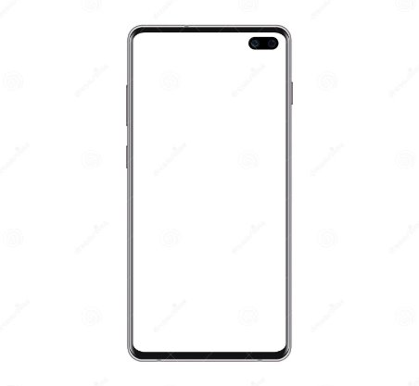
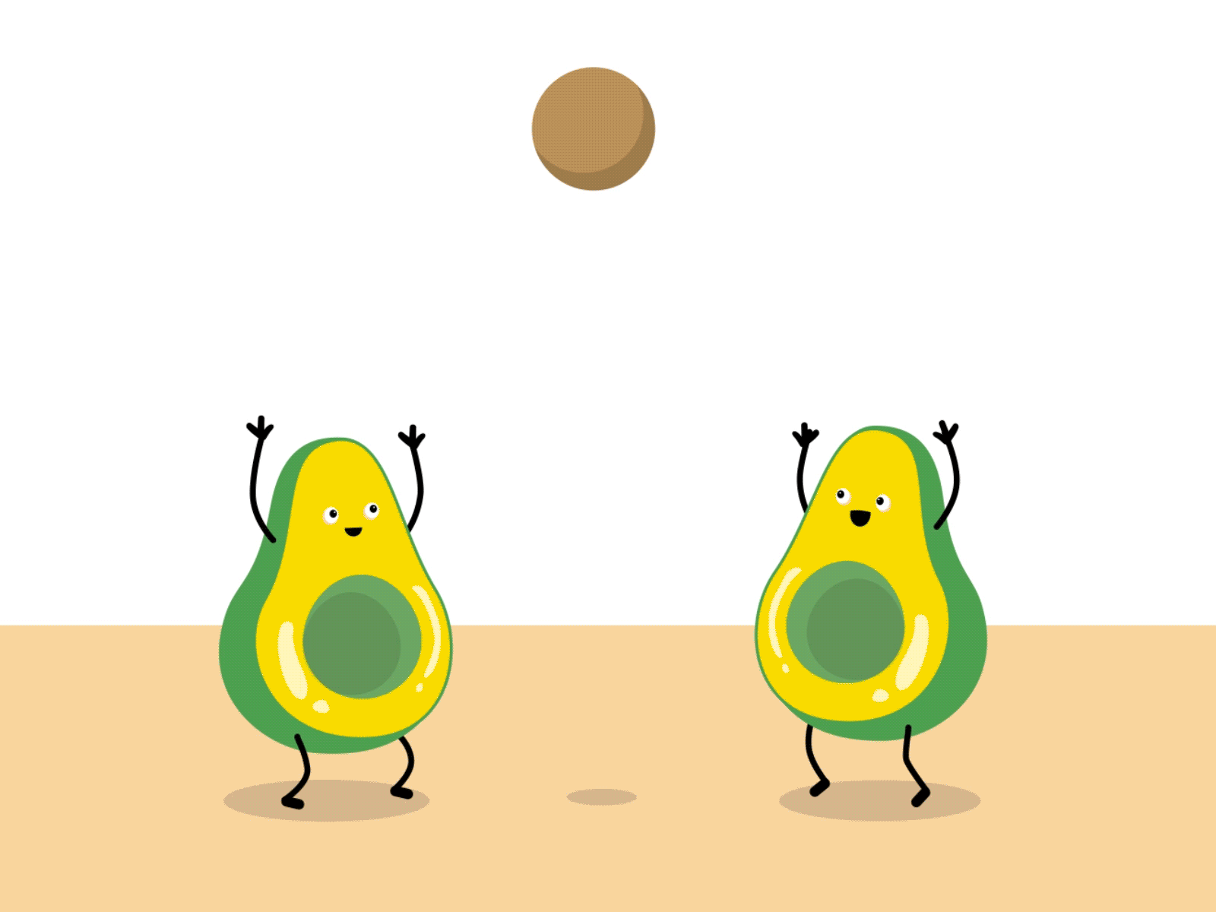
Brief Description of the Issue:​
Poor diet management is a common issue faced by many individuals, leading to various health problems such as obesity, malnutrition, and lifestyle diseases.

Slide 3

Challenges Faced by Individuals:
Lack of Knowledge: Many people are unaware of proper nutritional guidelines and the importance of a balanced diet.​
Time Constraints: Busy lifestyles make it difficult for individuals to plan, prepare, and track their meals.​
Difficulty in Tracking Nutritional Intake: People often struggle to monitor their daily intake of calories, macronutrients, and vitamins, leading to an unbalanced diet.​

Slide 4
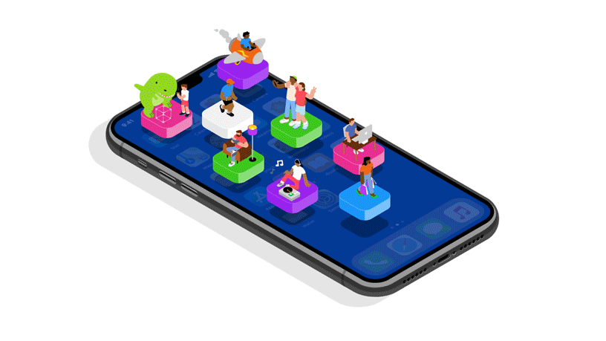
Introduction to the App:
Our solution is a user-friendly diet-handling mobile app designed to help individuals manage their nutrition and health more effectively.

Slide 5
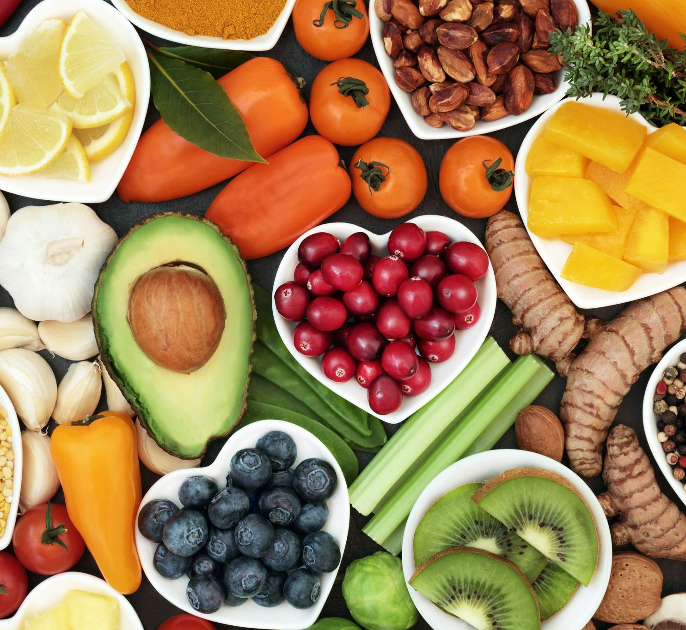
Key Features of the App:
Personalized Diet Plans: Tailor-made diet plans based on individual health goals, preferences, and dietary restrictions.
Nutrient Tracking: Real-time tracking of nutrient intake to ensure a balanced diet and meet daily nutritional needs.
Meal Reminders: Automated reminders for meals and snacks to help users stay on track with their diet.

Slide 6

Addressing the Problems:
The app solves the issues highlighted in the problem statement by providing knowledge and tools for effective diet management, saving time with automated features, and simplifying the tracking of nutritional intake.

Slide 7

Defining the Target Audience
Our app is designed for:
Health-Conscious Individuals: People looking to maintain or improve their overall health through better diet management.
Fitness Enthusiasts: Those who want to optimize their diet for performance, muscle gain, or weight loss.
Individuals with Specific Dietary Needs: People managing conditions like diabetes, hypertension, or allergies that require specialized diets.

Slide 8

Market Potential:
Growing Demand: The global market for diet and nutrition apps is expected to grow significantly, driven by increased awareness of health and wellness.
Consumer Trends: With rising concerns about health, more people are seeking tools that offer personalized and convenient solutions for diet management, positioning our app to meet this demand.

Slide 9
Title: Key Features and Technology
Personalized Diet Plans:
Customized plans based on age, height, weight, and goals.
Users can personalize and adjust their diet plans.
Real-time Progress Tracking:
Instant updates on fitness and diet progress.
Personalized recommendations based on progress.
Interactive User Interface:
Intuitive, user-friendly navigation.
Easy access to diet plans, progress, and goals.
Goal Setting and Reminders:
Set fitness goals and receive timely reminders.
Integration with Wearable Devices:
Sync with fitness devices for accurate tracking and data analysis.
Community Support and Sharing:
Share progress and tips within the app's community.

Slide 10

Technology Stack:
Programming Languages: Dart
Frameworks: Flutter (cross-platform development)
Databases: Firebase Firestore, Firebase Realtime Database
Backend: Firebase Authentication
Storage: Firebase Cloud Storage
Analytics: Firebase Analytics
Unique Algorithms and AI:
Diet Plan Optimization:
Proprietary algorithm for balanced, goal-aligned plans.
AI-Driven Recommendations:
Personalized suggestions based on user behavior and progress.

Slide 11
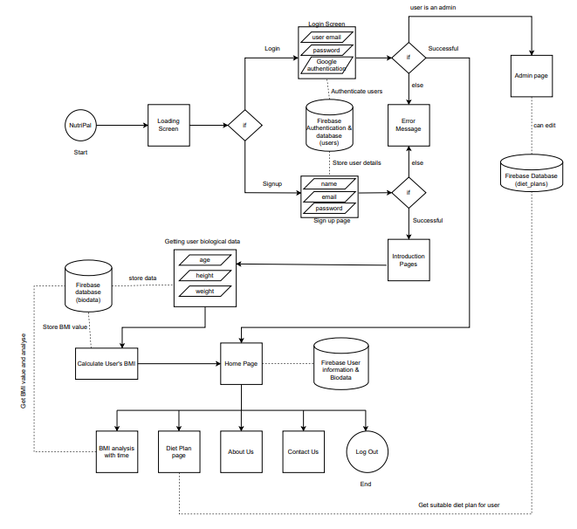
Architecture Diagram and Repository Link
https://github.com/hashanwijemanna/NutriMob

Slide 12

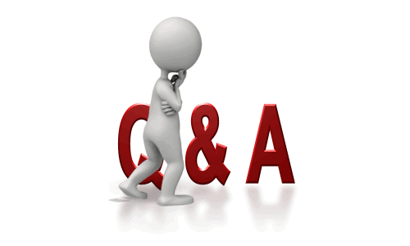
Q & A Time

